Slide 1
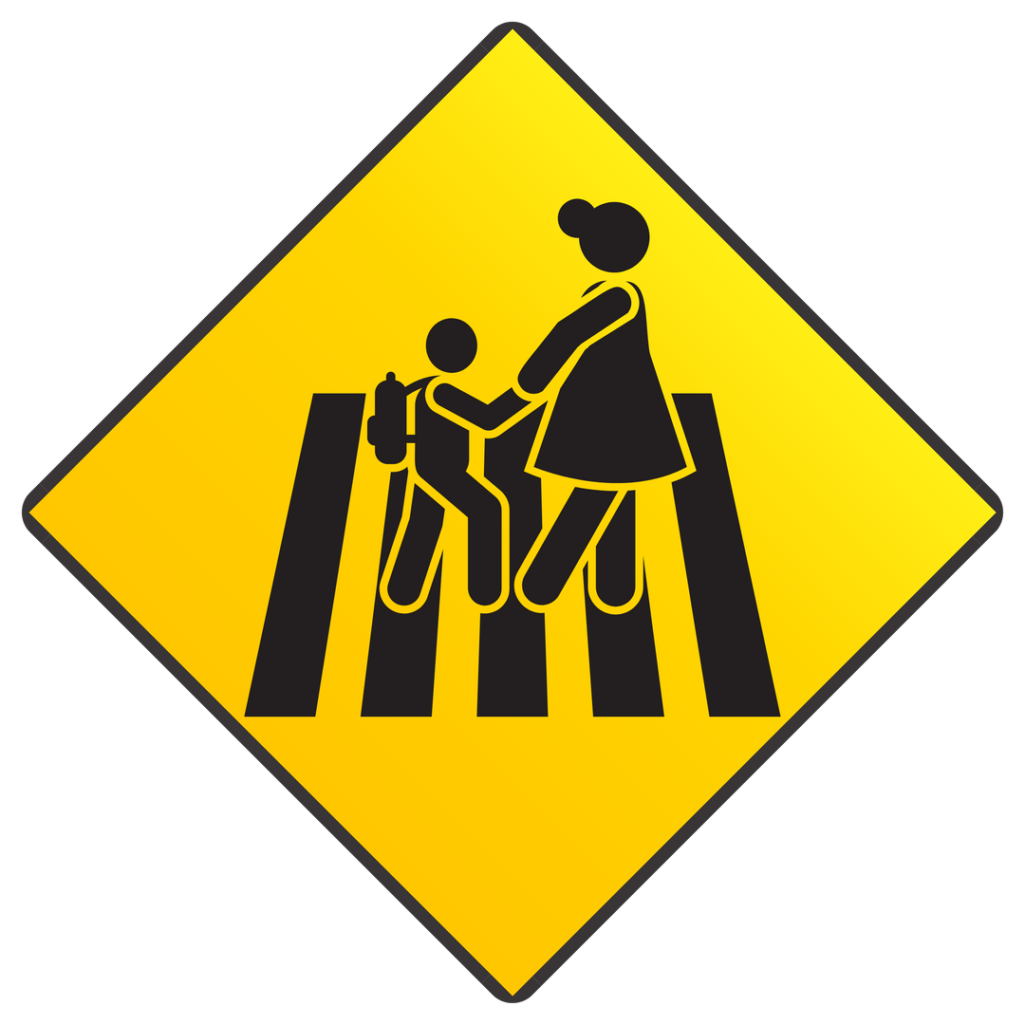

Citizens for Road Safety
Texans deserve safe streets.
This presentation is approved by TxDOT, under grant 2025-FortBend-G-1YG-0081
Citizens for Road Safety
Stop and Yield
2024

Slide 2
Lisa Torry Smith Act
Lisa Torry Smith was a mother and entrepreneur killed crossing her son to school in the middle of a crosswalk in a school zone on her way to Jan Schiff Elementary School in Fort Bend County, Texas in 2017.
At the time of Lisa’s death, it was not a crime in Texas to kill or injure someone in a crosswalk.
Making Texas history: With the help of Fort Bend County District Attorney Brian Middleton, state Senator Joan Huffman, state Representative Ron Reynolds, Fort Bend County Sheriff Eric Fagan, Bike Texas and Texas Farm & City, the Lisa Torry Smith Act was passed.
The new Texas Crosswalk law was a bipartisan effort.
Citizens for Road Safety

Slide 3
Lisa Torry Smith Act
The Lisa Torry Smith Act was signed into law by Governor Greg Abbott in September 2021.
The new law makes killing or injuring a pedestrian or other vulnerable road user in a crosswalk a crime in Texas. Drivers that injure or kill a pedestrian lawfully in a crosswalk may now be charged with a misdemeanor or felony in Texas.
The law requires drivers to: Stop & Yield to people lawfully in the crosswalk.
Implementation of the new law will require a statewide effort by state and local government as well as civil society.
Citizens for Road Safety

Slide 4
THE NEW TEXAS CROSSWALK LAW: HOW IT WORKS
The Lisa Torry Smith Act amended Sections 544.007(b) and (c), 552.002(b), and 552.003(a) and (c) of the Texas Transportation Code to require drivers to “Stop and Yield” the right of way to pedestrians lawfully in the intersection or an adjacent crosswalk.”
The previous version of the law only required drivers to “Yield” the right of way to other vehicles and pedestrians.”
Citizens for Road Safety

Slide 5
THE NEW TEXAS CROSSWALK LAW: HOW IT WORKS
Drivers Shall Stop and Yield
the right-of-way to pedestrians lawfully a crosswalk
Citizens for Road Safety

Slide 6
THE NEW TEXAS CROSSWALK LAW: HOW IT WORKS
The operator of a vehicle shall stop and yield the right-of-way to a pedestrian crossing a roadway in a crosswalk if:
No traffic control signal is in place or in operation; and
The pedestrian is: on the half of the roadway in which the vehicle is traveling; or approaching so closely from the opposite half of the roadway as to be in danger.
Citizens for Road Safety

Slide 7
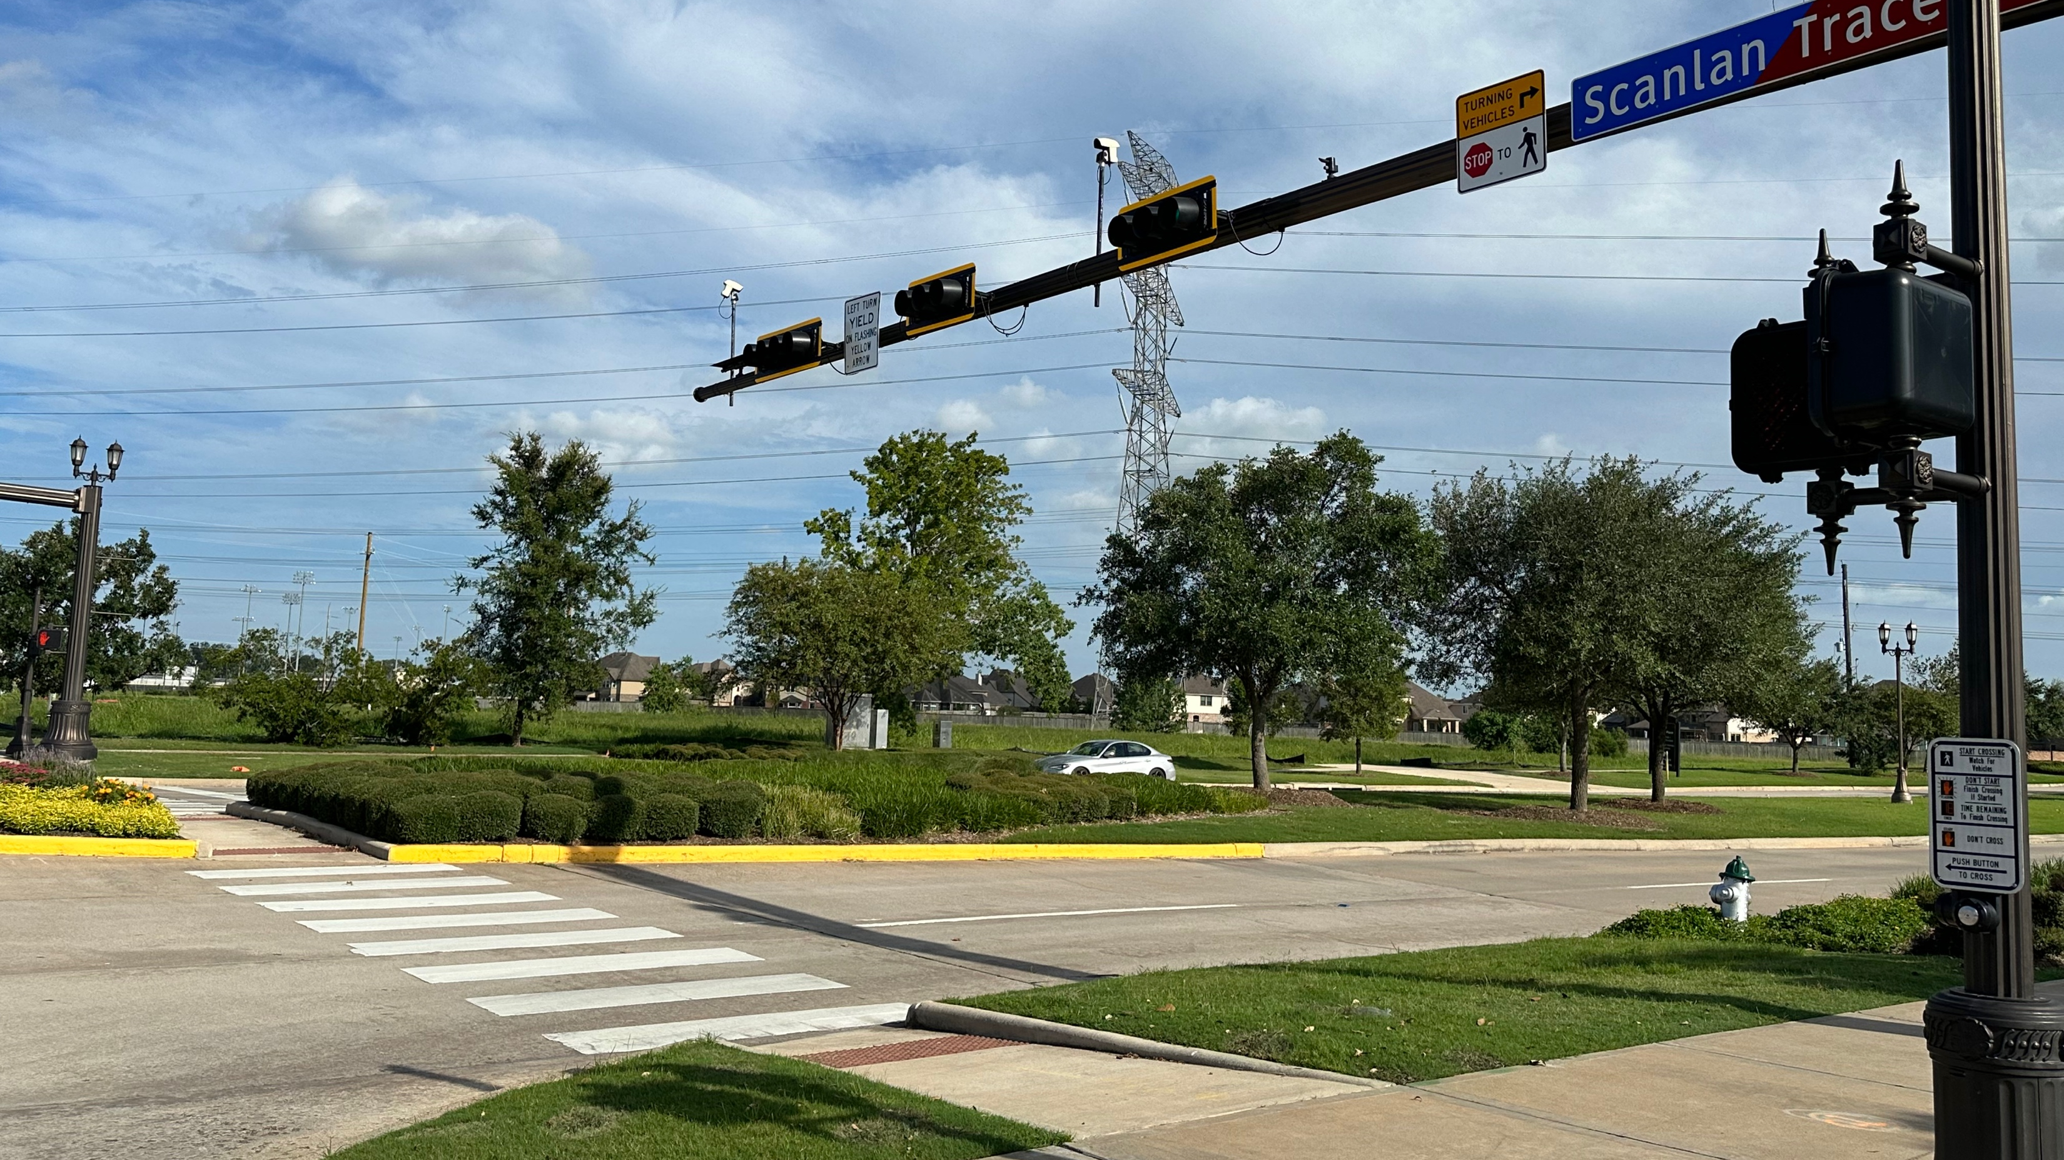
WHAT MUST DRIVERS DO
AT A CROSSWALK?
Citizens for Road Safety

Slide 8
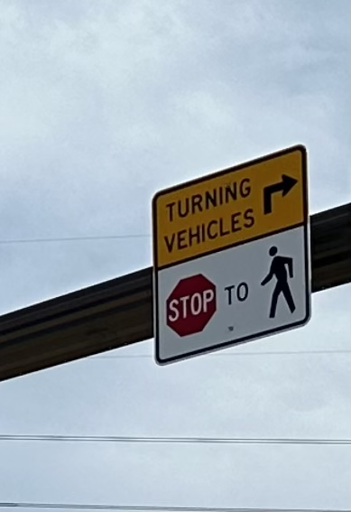
THE NEW TEXAS CROSSWALK LAW
HOW IT WORKS
Citizens for Road Safety

Slide 9
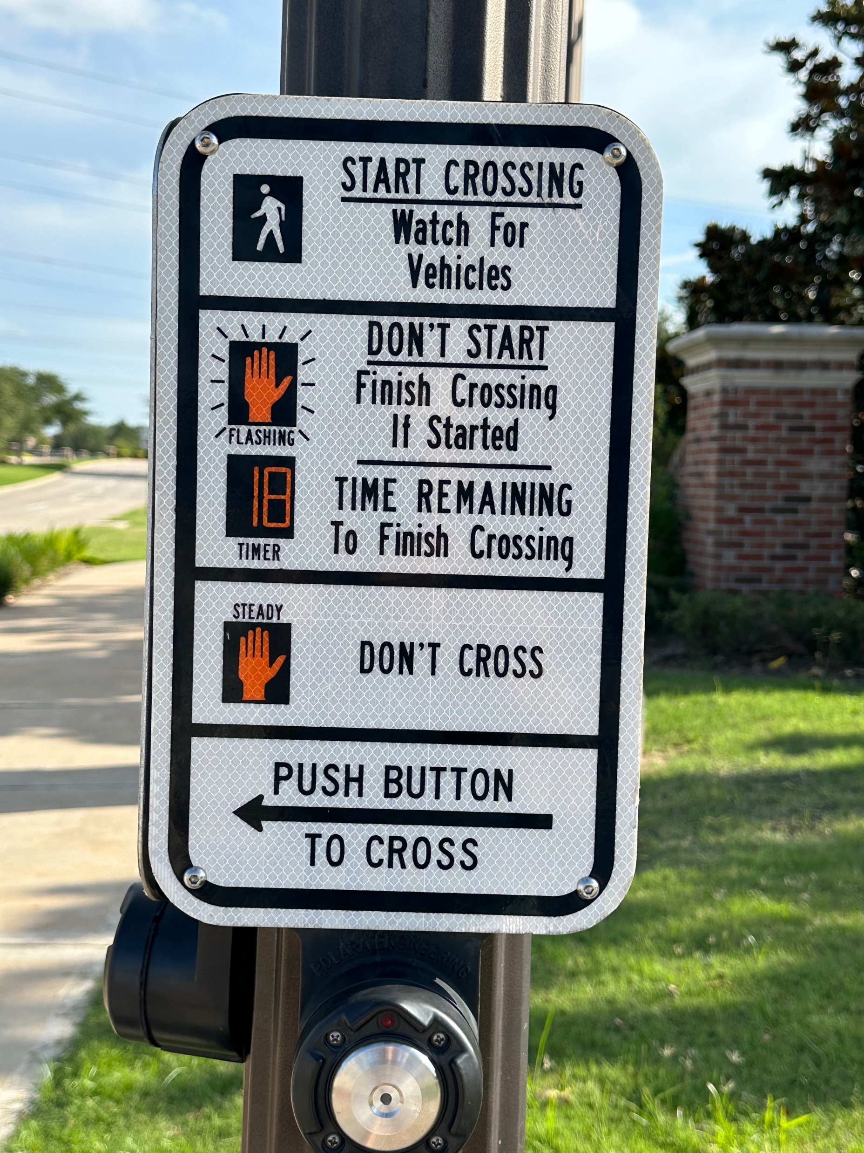
THE NEW TEXAS CROSSWALK LAW
HOW IT WORKS
Citizens for Road Safety

Slide 10
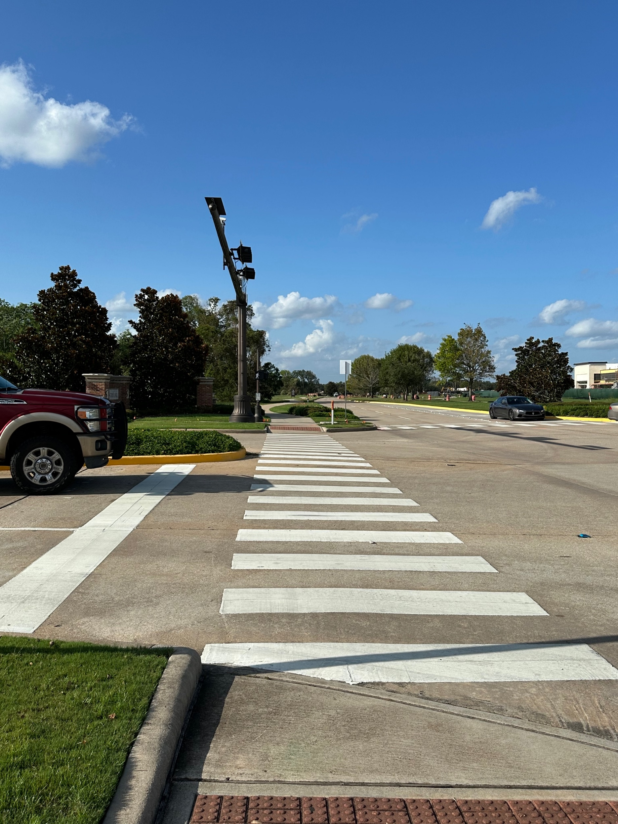
THE NEW TEXAS CROSSWALK LAW
HOW IT WORKS
Citizens for Road Safety

Slide 11
THE NEW TEXAS CROSSWALK LAW: HOW IT WORKS
The operator of a vehicle shall stop and yield the right-of-way to a pedestrian crossing a roadway in a crosswalk if:
Traffic control signal is in place or in operation; and the pedestrian is:
  On the half of the roadway in which the vehicle is traveling; or Approaching so closely from the opposite half of the roadway as to be in danger.
  Notwithstanding, a pedestrian may not suddenly leave a curb or other place of safety and proceed into a crosswalk in the path of a vehicle so close that it is impossible for the vehicle operator to stop and yield.
Citizens for Road Safety

Slide 12
THE NEW TEXAS CROSSWALK LAW: HOW IT WORKS
CROSSING THE STREET IN A CROSSWALK WITH A LIGHT AND SIGNAL
An operator of a vehicle facing a circular green signal may proceed straight or turn right or left unless a sign prohibits the turn. The operator shall, while the signal is exhibited:
Yield the right-of-way to other vehicles lawfully in the intersection when the signal is exhibited; and
Stop and yield the right-of-way to pedestrians lawfully in the intersection or an adjacent crosswalk.
      An operator of a vehicle facing a green arrow signal, displayed alone or with another signal, may cautiously enter the intersection to move in the direction permitted by the arrow or other indication shown simultaneously. The operator shall stop and yield the right-of-way to a pedestrian lawfully in an adjacent crosswalk and shall yield the right-of-way to other traffic lawfully using the intersection.
Citizens for Road Safety

Slide 13
THE NEW TEXAS CROSSWALK LAW: HOW IT WORKS
CROSSING THE STREET IN A CROSSWALK WITH A LIGHT AND SIGNAL
Texas Transportation Code - TRANSP § 552.001. Traffic Control Signals
A traffic control signal displaying green, red, and yellow lights or lighted arrows applies to a pedestrian as provided by this section unless the pedestrian is otherwise directed by a special pedestrian control signal.
A pedestrian facing a green signal may proceed across a roadway within a marked or unmarked crosswalk unless the sole green signal is a turn arrow.
A pedestrian facing a steady red signal alone or a steady yellow signal may not enter a roadway.
Citizens for Road Safety

Slide 14
THE NEW TEXAS CROSSWALK LAW: HOW IT WORKS
CROSSING THE STREET IN A CROSSWALK WITH A LIGHT AND SIGNAL
Section 552.002(b), Transportation Code, is amended to read as follows:
Pedestrian facing a "Walk" signal may proceed across a roadway in the direction of the signal, and the operator of a vehicle shall stop and yield the right-of-way to the pedestrian.
552.002(c) remains in effect and states: A pedestrian may not start to cross a roadway in the direction of a “Don’t Walk” or a “Wait” signal. A pedestrian who has partially crossed while the “Walk” signal is displayed shall proceed to a sidewalk or safety island while the “Don’t Walk” signal or “Wait” signal is displayed.
Citizens for Road Safety

Slide 15
THE NEW TEXAS CROSSWALK LAW: HOW IT WORKS
CROSSING IN A CROSSWALK IN ALLEY, BUILDING, OR PRIVATE ROAD OR DRIVEWAY
The operator of a vehicle emerging from or entering an alley, building, or private road or driveway shall stop and yield the right-of-way to a pedestrian approaching on a sidewalk extending across the alley, building entrance or exit, road, or driveway.
Citizens for Road Safety

Slide 16
THE NEW TEXAS CROSSWALK LAW: HOW IT WORKS
POTENTIAL CHARGES
The Act added Section 545.428, which indicates:
“A person commits an offense if the person with criminal negligence:
Operates a motor vehicle within the area of a crosswalk; and
(2) Causes bodily injury to a pedestrian or a person operating a bicycle, motor-assisted scooter, electronic personal assistive mobility device, neighborhood electric vehicle, or golf cart.”
Citizens for Road Safety

Slide 17
NEED FOR WIDESPREAD AWARENESS-RAISING
LAW ENFORCEMENT
GENERAL PUBLIC
YOUTH
Citizens for Road Safety

Slide 18
NEED FOR TRANSFORMATION: A COMPASSIONATE DRIVING CULTURE
DRIVERS SHOULD SEE THEMSELVES AS PILOTS OF AIRPLANES, RESPONSIBLE FOR THE LIVES OF THOSE ON BOARD AND THE SAFETY AND SECURITY OF EVERYONE AND EVERYTHING THEY PASS.
KINDNESS AND COURTESY
SELFISH BEHAVIOR ON THE ROAD ENDANGERS LIVES
SET OUT IN YOUR CAR AS A PROTECTOR NOT A KILLER
Citizens for Road Safety

Slide 19
WE ALL HAVE A RESPONSIBILITY TO SHARE THE ROAD RESPONSIBLY
Tips for driving in school zones
Be aware that traffic patterns around school zones may have changed since the last school year.
Stay alert and put your cell phone away. Using a handheld electronic device while driving in an active school zone is against the law.
Always obey school zone speed limit signs. Remember, traffic fines increase in school zones.
Drop off and pick up your children in your school’s designated areas, not the middle of the street.
Keep an eye on children gathered at bus stops.
Watch for children who might dart across the street or between vehicles.
As always, stay away from alcohol and other drugs that may impair driving. They affect your ability to remain alert, decision-making, reflexes, and reaction time.
Citizens for Road Safety

Slide 20
WE ALL HAVE A RESPONSIBILITY TO SHARE THE ROAD RESPONSIBLY
Tips for children walking or biking to school
Always use sidewalks. If there’s not a sidewalk, walk on the left side of the street facing traffic.
Cross the street at intersections or marked crosswalks. Look left, right and left again before proceeding.
Always obey crossing guards.
Make eye contact with drivers before crossing the street. Never assume a driver sees you.
Look for traffic when stepping off a bus or from behind parked vehicles.
Always wear a helmet when riding a bicycle.
Don’t be distracted by electronic devices that take your eyes and ears off the road.
Follow all traffic rules, signs and signals.
Citizens for Road Safety

